Slide 1
My Experience as a SOFI Intern
with the Risk Infrastructure Team

Slide 2

Introduction
My name is Daniel Eduardo Oliver
I’m from Seattle, WA
MS Computational Finance and Risk Management
Applied Mathematics Department at the University of Washington
BA Jazz Studies on Piano from UW
BA Business Administration Accounting from UW Tacoma

Slide 3
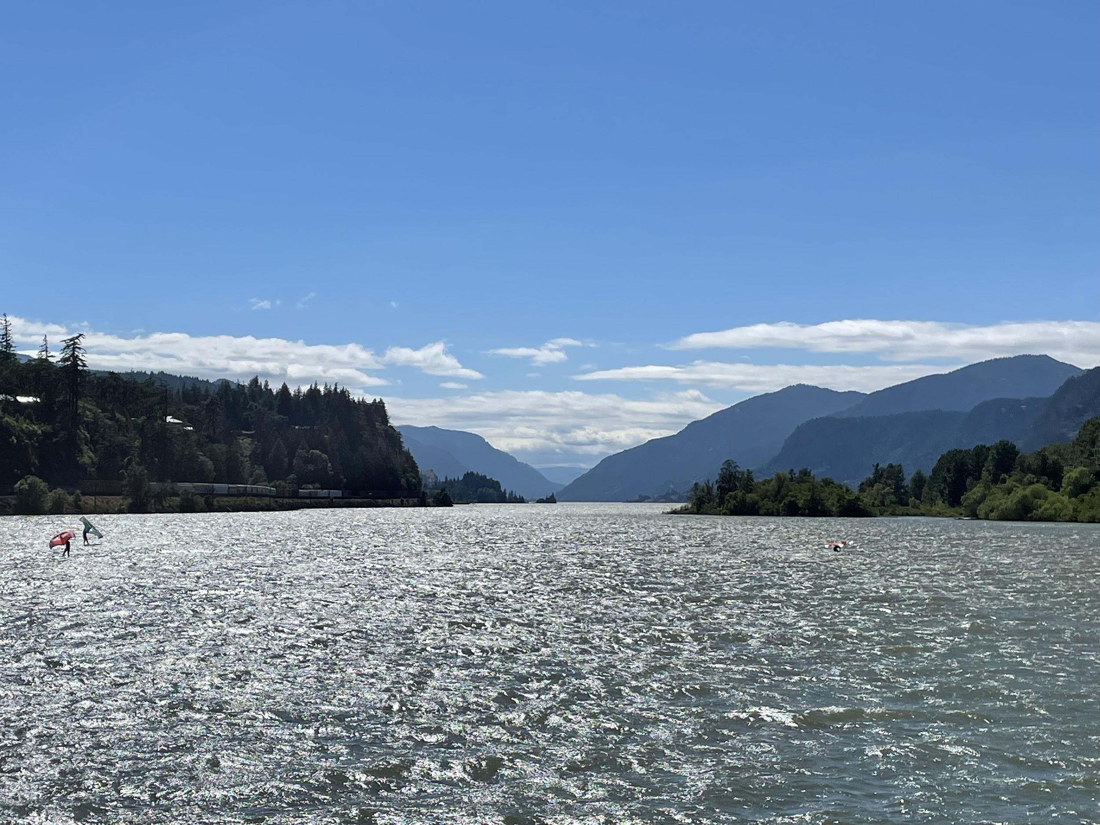
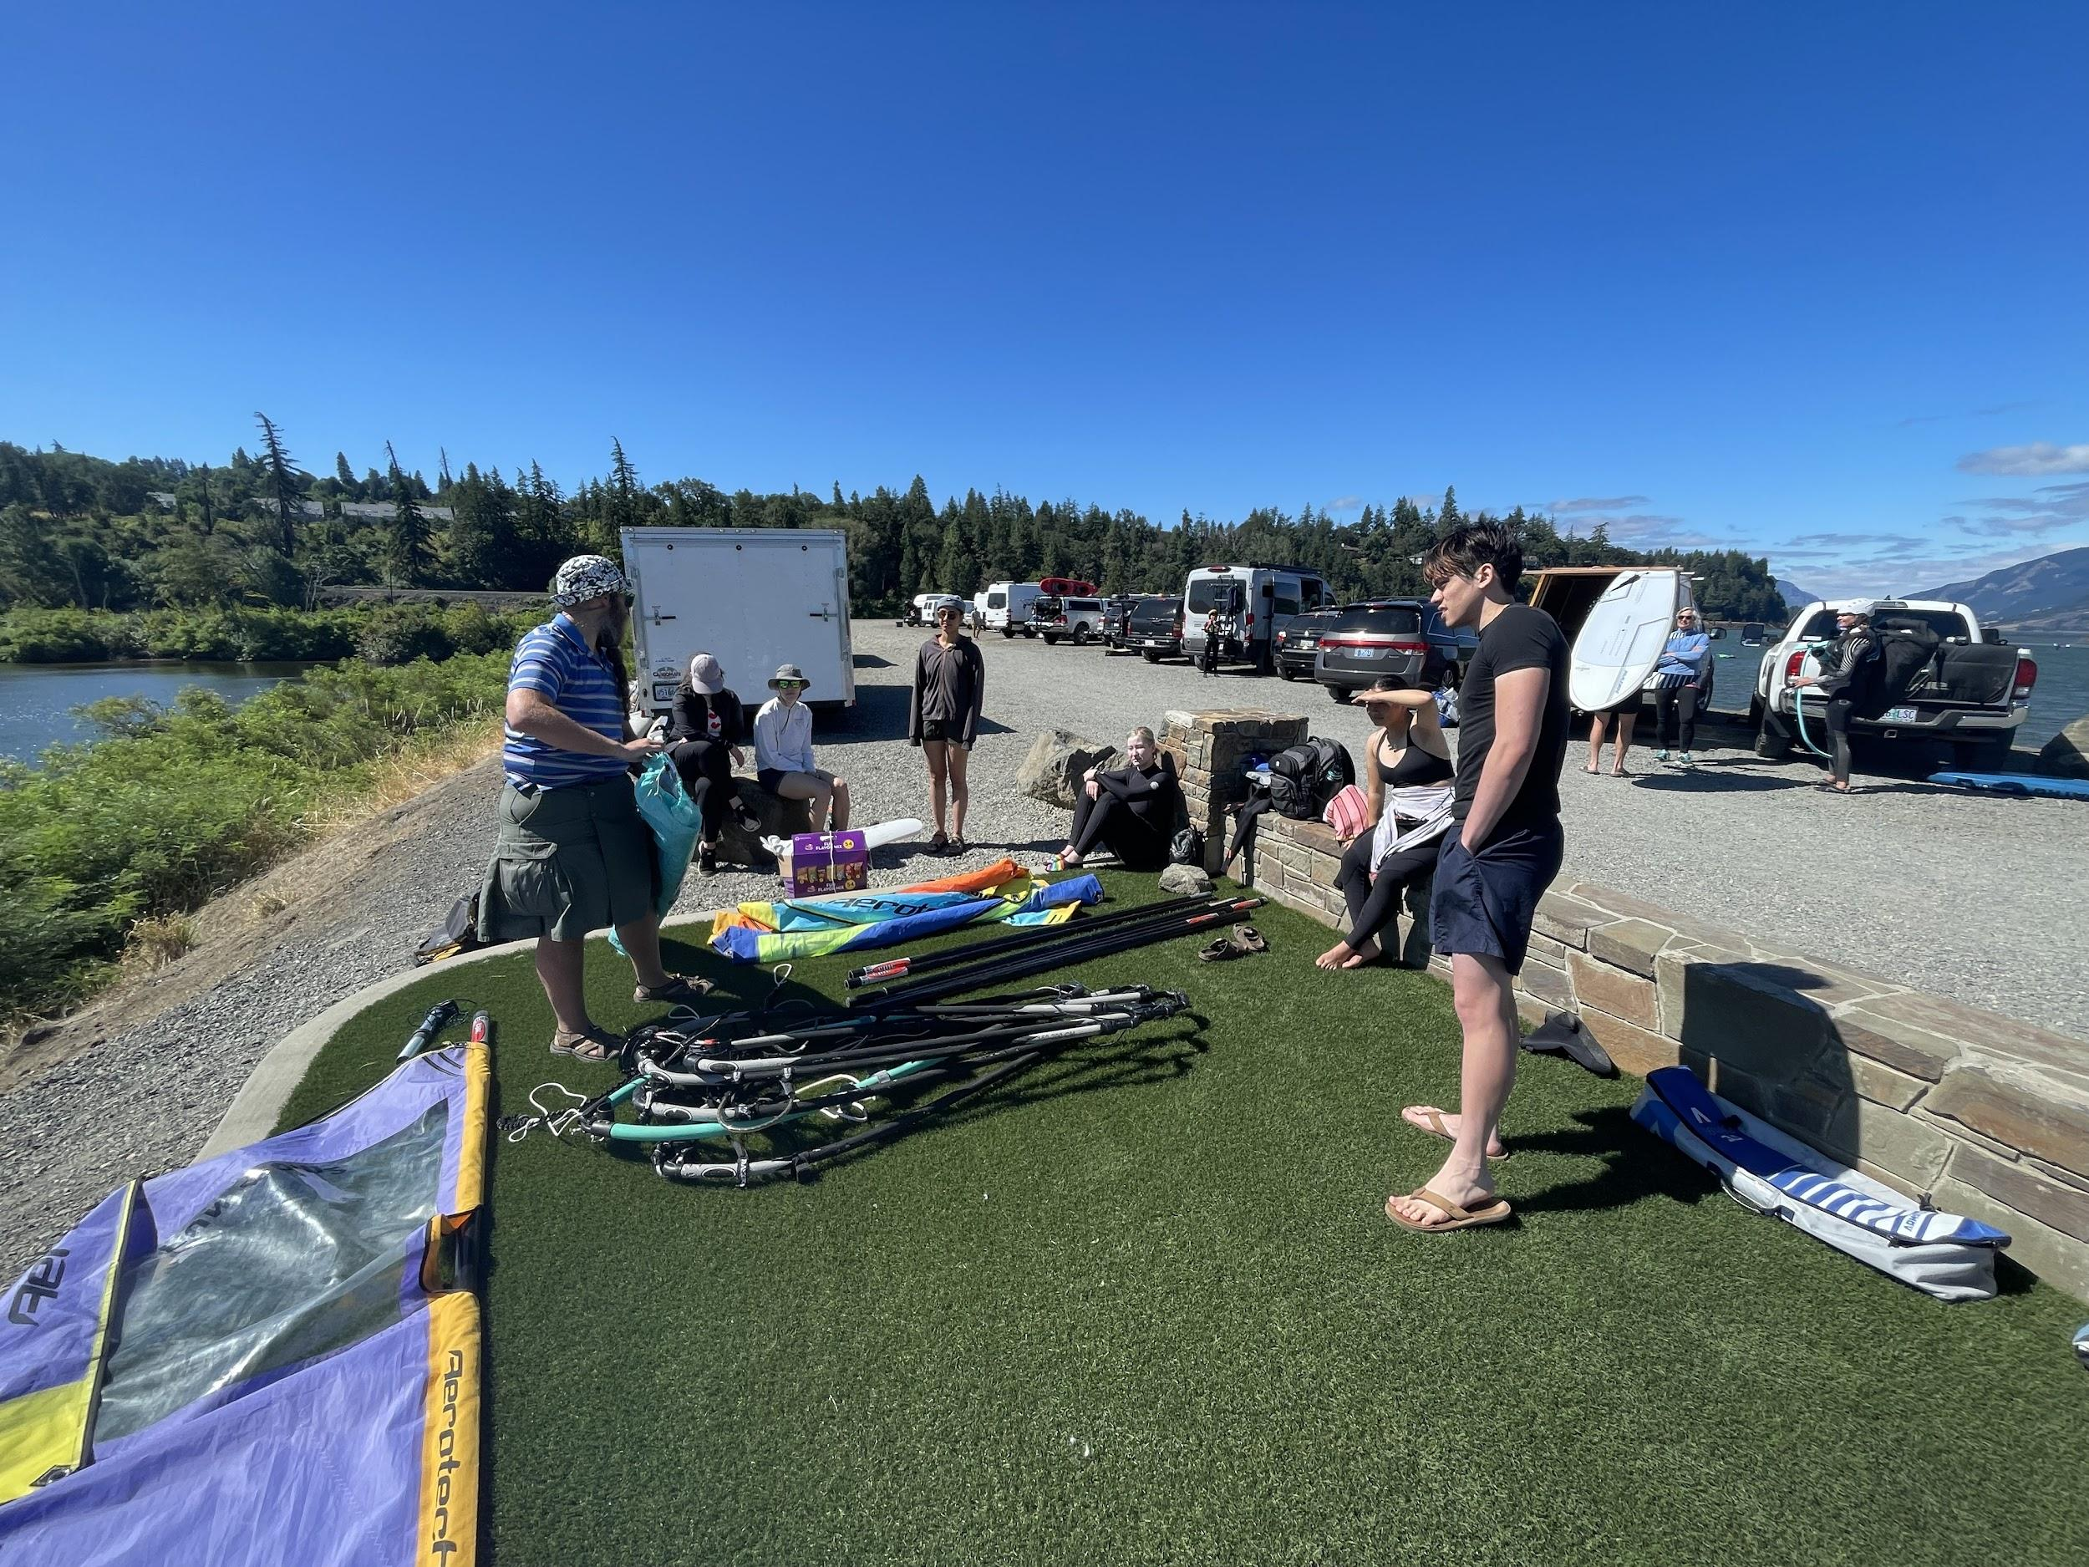

Introduction
I teach windsurfing for the Washington Yacht Club and Sail Sand Point

Slide 4

Risk Infrastructure Team
Develops risk strategies for decision making
Shout Outs to: Svetlana, Sanskruti, Joey, Douglas, and Carlos

Slide 5
My Projects
csv_build Development and Integration
regression_writer Development and Integration
Data Validation

Slide 6
csv_build: Business Purpose and Benefits
Purpose
Build program that creates filtered csv files from google spreadsheets to allow for easy data testing
Benefits
Filter data without use of the Knime tool
Faster to run tests
Expedites developers’ communication and pipeline runs
Easy to use
Saves money

Slide 7
csv_build: Development
Developed correct parsing of google sheet data to csv files
Created filters for data
field_name: Column name in data
field_value: column value desired
rows: returns select rows of data
csv_max_rows: sets maximum rows per csv file
Integration with RI Projects and regression_writer
Notes:
**(give demonstration of filtering)** SAFE CC, rows , field_name scenario, 1,2,3,4,5
Challenges i encountered:
In many cases, I was handed semi-functioning code that I would have to learn how it functioned and what it produced. These scripts included APIs and Python libraries that I wasn’t familiar with which lead to a lot of reading of documentation.
Getting projects integrated correctly was difficult. Often many of the google spreadsheet names and locations were no longer the same of that in the project which lead to many errors along the way of integrating RI projects with build_csv and regression_writer

Slide 8
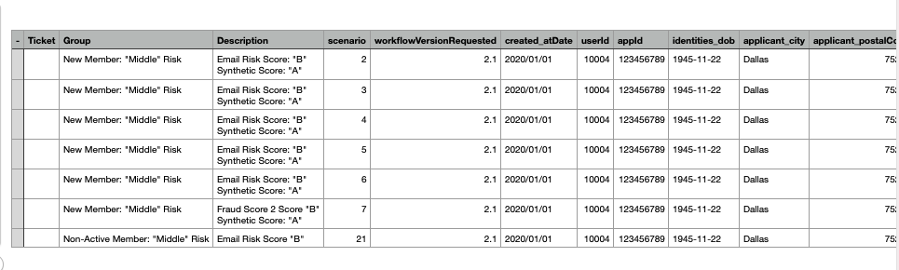
rows: 1,2,3,4,5,6,20

Slide 9
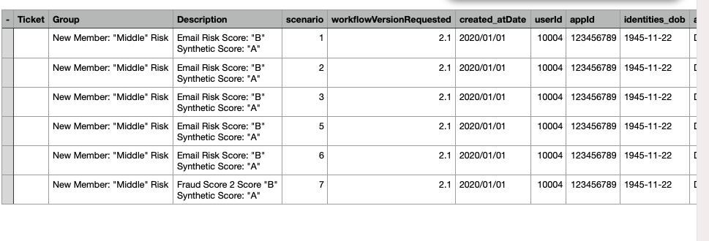
field_name: scenario
field_value: 1,2,3,5,6,7

Slide 10
csv_build: Challenges
Debugging and building on prior created semi-functioning Python scripts
Integration difficulties
Notes:
**(give demonstration of filtering)** SAFE CC, rows 1,2,3,4,5,6,20
, field_name scenario, 1,2,3,5,6,7
Challenges i encountered:
In many cases, I was handed semi-functioning code that I would have to learn how it functioned and what it produced. These scripts included APIs and Python libraries that I wasn’t familiar with which lead to a lot of reading of documentation.
Getting projects integrated correctly was difficult. Often many of the google spreadsheet names and locations were no longer the same of that in the project which lead to many errors along the way of integrating RI projects with build_csv and regression_writer

Slide 11
csv_build: What I Learned
Development with Gitlab
Integration with other Projects
Working in the Terminal
git command lines
Bash code
Googlesheets API
New Python Libraries
argparse
Use of various file types
.yaml, .config, DockerFile

Slide 12
Data Validation: Business Purpose and Benefits
Purpose
Compare data between different environments for data validation
Soon to be expanded with a UI to the engine functionality itself
Benefits
Allow business/strategy side of SoFi to pull their own data
Remove dependency on RI Team

Slide 13
Data Validation: Development
Variables added
Rows: select number of rows desired
Date: date range of data desired
SQL Query
Where clause: customizing where clause
Error handling: graceful exit when no data found

Slide 14
Data Validation: Challenges
Building off of previously built Python scripts
Working with brand new Python libraries and APIs, such as airflow
Setting up local environment with
AWS
Strong DM
Snowflake

Slide 15
Data Validation: What I Learned
SQL integration with Python
APIs
Snowflake
Airflow
Strong DM
“Requests” Python Library to retrieve data

Slide 16
Wrapping Up!
With more time I would…
Work to complete the necessary changes to Data Validation Project
Further the development of UI
Continue developing the usability of csv_build project and maintain its proper integration with RI projects
Continue learning by reading through Python library and API documentation

Slide 17
Takeaways
Work my way through a steep learning curve
Able to apply my skills
Confident
Built up my Python developer arsenal of tools
RI team is helpful and productive
SoFi is a great place to work!

Slide 18
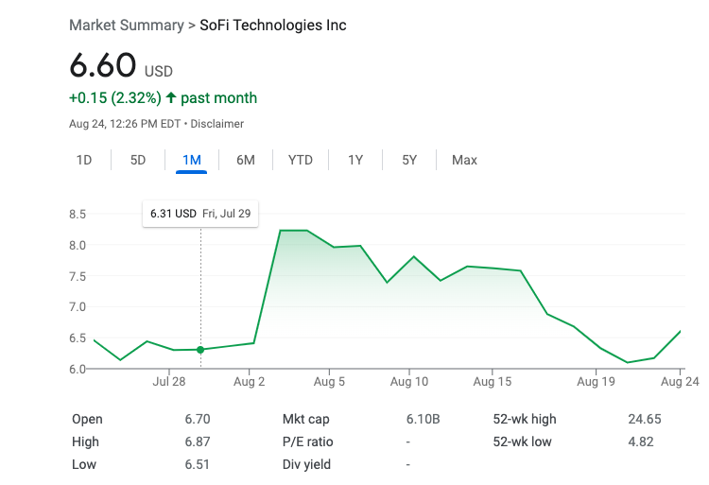

Thank You!

